Slide 1
1. How to scrape metrics for a new application? Can you explain with an example?

Slide 2
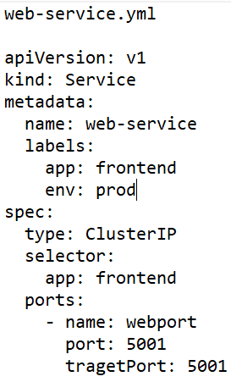
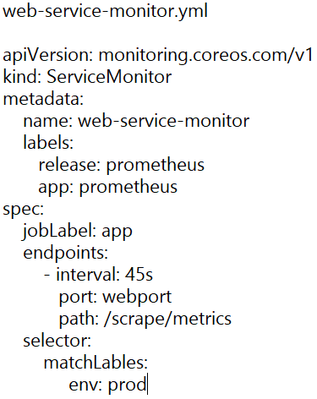
1. How to scrape metrics for a new application? Can you explain with an example?
We can use service monitors to scrape metrics for a new application. As I am using Prometheus, so I can set targets for it to monitor and scrape. For example if we have a service running inside a K8s cluster which we want to monitor, we can create a resource of kind ServiceMonitor and use the labels of the service inside the spec section of our service monitor to scrape the metrics.

Slide 3
2. Have you deployed any application to EKS? How?

Slide 4
2. Have you deployed any application to EKS? How?
Yes, I have deployed multiple applications on EKS. The first thing is to develop the application locally on a dev machine, containerize it, and test it. If it runs successfully, then push it to ECR. Now, to deploy this to AWS EKS, you should have a cluster, we create clusters with Terraform IaC. Now, we need to create deployment, service, configmaps manifests etc. We utilize Helm Charts to deploy our applications. Also, we utilize ALB Ingress Controller for routing traffic to our backend services and use Route53 for DNS configuration. To control developer access, we use RBAC. Most of our K8s applications utilize AWS RDS instances for DB using a controller called ACK-RDS-Controller. The application source code, Dockerfile, Helm Charts etc reside in GitLab. We follow GitOps approach using ArgoCD.

Slide 5
3. List a few automation tasks that you have completed.

Slide 6
3. List a few automation tasks that you have completed.
I worked on automatic shutdown and restart of some of the EC2 instances in the off hours as those were under-utilized. I used AWS SDK for python (Boto3) with Lambda and scheduled those using AWS Eventbridge cron jobs.
I helped the security team in configuring ECR Image scanning results to an email . I deployed a standalone docker container on an EC2 instance with a docker image that is able to scan our ECR repositories and post results on our scanning tool UI (Tenable in my case). This docker container will run in loop and continue to scan the repositories. Then, from the Tenable UI, an email with those scan results can be triggered on a schedule.

Slide 7
4. What do you understand by the terms SLIs, SLOs, and SLAs?

Slide 8
4. What do you understand by the terms SLIs, SLOs, and SLAs?
These are important terms when it comes to SRE. It is used to measure the service reliability:
SLIs (Service Level Indicators): It defines the reliability of a service by numerical indicators to measure it over a period of time. These metrics can indicate the overall health, performance, or latency of a service. Example: latency, throughput, and errors occurred per X number of requests.
SLOs (Service Level Objectives): These are the range of values of SLIs that needs maintenance for a service to be acceptably reliable. Example: 0.1 to 0.5% of 404 errors are acceptable for a specific application.
SLAs (Service Level Agreements): It defines the agreement on the levels of service expected by the end users as defined through SLOs. Generally it is the actual contractual agreement between the service provider and end users (or customers). Example: If Service A goes down impacting 100+ users, the service should be restored within 2 hours as this is a Priority 1 incident.

Slide 9
5. What is the toughest challenge that you have faced? How did you overcome it?

Slide 10
5. What is the toughest challenge that you have faced? How did you overcome it?
This is related to a Drupal application that I manage and is critical to customer business. One day, the service went down on Monday morning after a recent change by the developer team. The issue quickly got escalated as the CEO was also impacted. We all got on a call to troubleshoot the issue. The site was throwing an error related to php-fpm service failing. I tried to roll back the change to the previous version but it did not work. Then suddenly I remembered that there is a Drupal community which provides troubleshooting steps to known issues. I tried to search the error message there and luckily I found the troubleshooting steps. I quickly followed it and re-configured php-fpm service and restarted it. The site came back up within 25 minutes. We received appreciation from the CEO himself.

